Slide 1


Self-Care Application
SHRI RAMDEOBABA COLLEGE OF ENGINEERING AND MANAGEMENT, NAGPUR
Department of Information Technology
Sem -VII (2022-23)
Project Seminar on -
by
Anshul Sharma (30)
Aryan Khandelwal (34)
Raunak Gandhi (51)
Under the guidance of
Prof. Ashish Chandak
IT Department, RCOEM, Nagpur

Slide 2
Contents
Problem Definition
Introduction
Flow chart of operations
Application Advantages
Current Status
Timeline
References

Slide 3
Problem Definition
A utility application that provides the user with various resources related to self-care domain and signifies the importance of self-care which helps an individual to live well and improve the quality of life.

Slide 4
Introduction
Self-care is intending, planning and actually taking the time to attend to your basic physical, mental and emotional needs – and making sure you get it. It is the conscious rest which helps you recharge your batteries. It is not inherently indulgent or selfish, it is necessary.
As adults, we are solely responsible for managing our own health, emotions, and personal growth. Self-care is the set of practices that allow us to accomplish this. The first step in quality self-care is to learn what it is and understand its importance.

Slide 5
Introduction (contd.)
Self-care should not be viewed as something you only do if you have time. Neither is self-care something that should only be a reward that can be gained once other tasks are completed.
Self-care, if practiced appropriately, needs to be an integral part of your daily life. Fortifying your emotional, physical, and spiritual health through self-care is the foundation for your overall health and well-being.

Slide 6
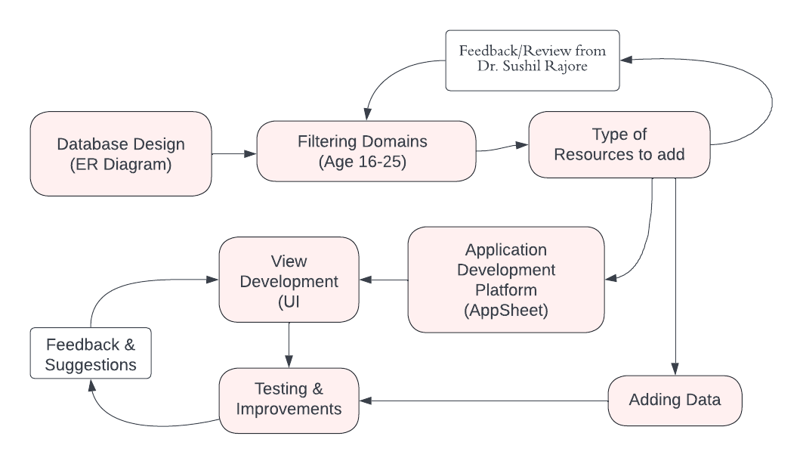
Flow Chart of Operations

Slide 7
Application Advantages
This application will provide users all the required information in one place.
The application will only consist of the data which is fully authenticated and highly rated and has already been used by users.
It will help the users to understand the need of self-care.
This will make users aware of the importance of self-care & why one need to take care of themselves.

Slide 8
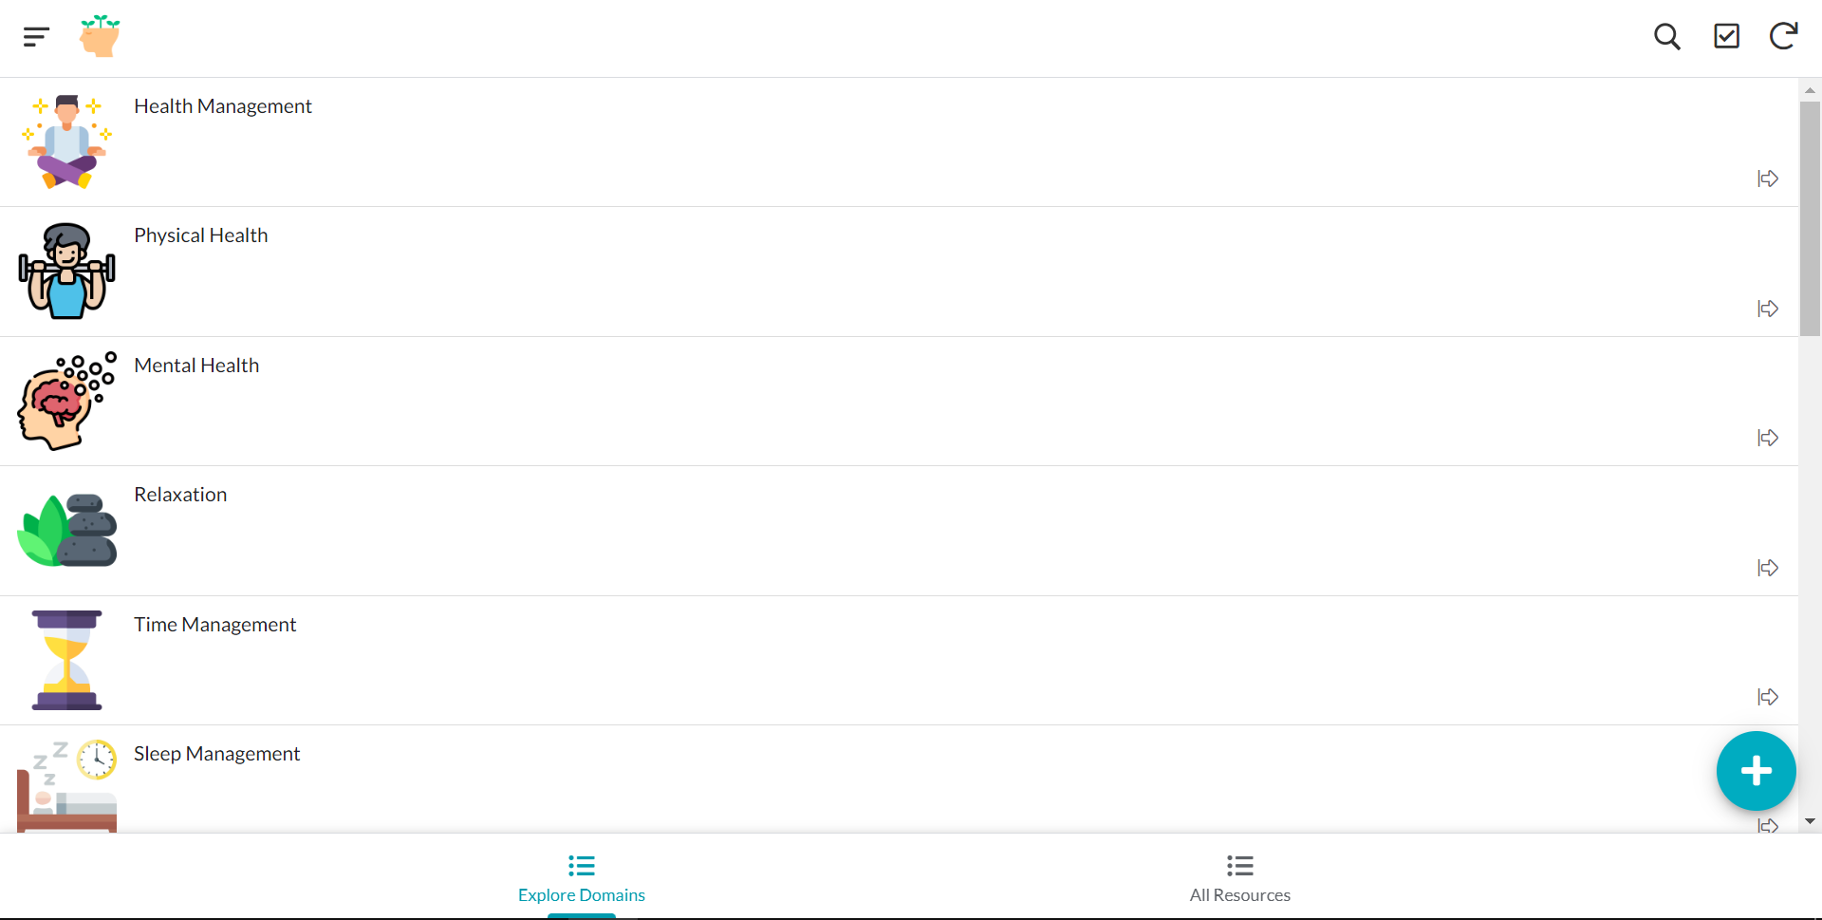
Current Status
Application view on Desktop

Slide 9
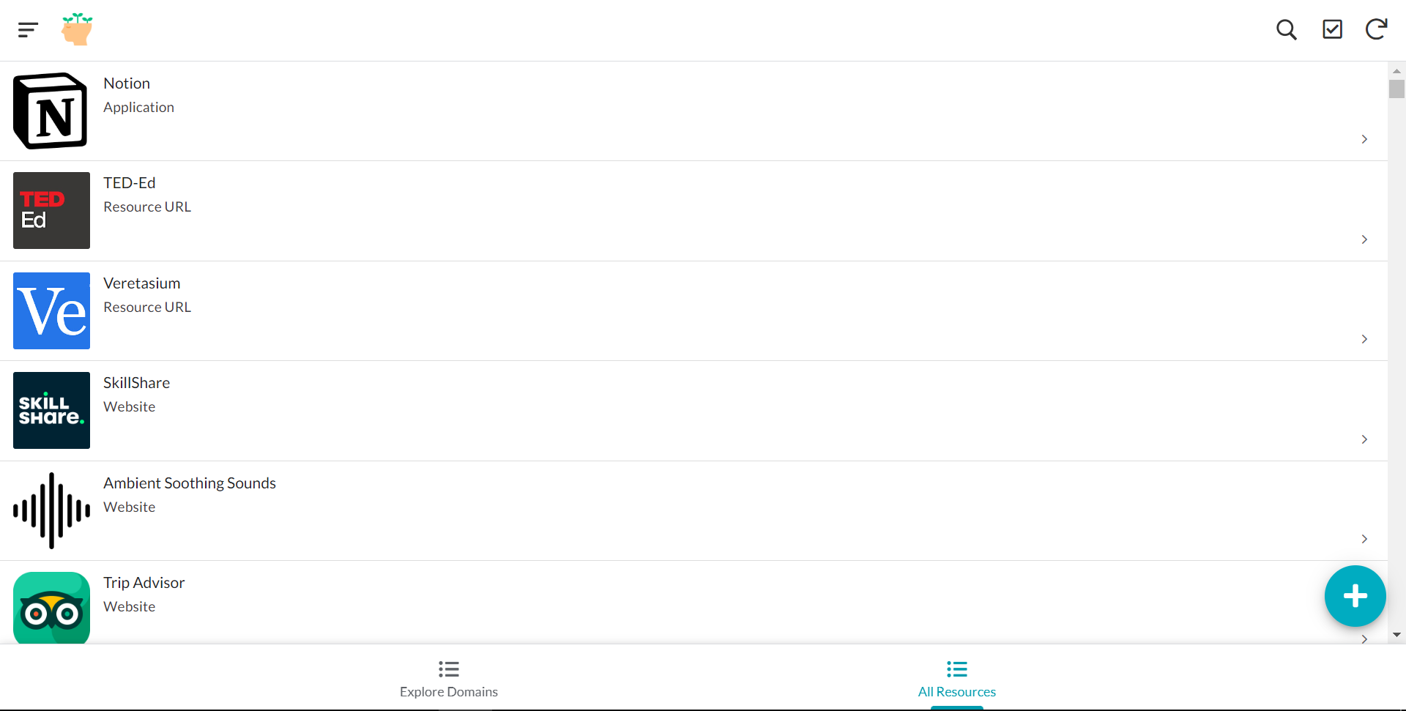
Current Status (contd.)
Application view on Desktop

Slide 10
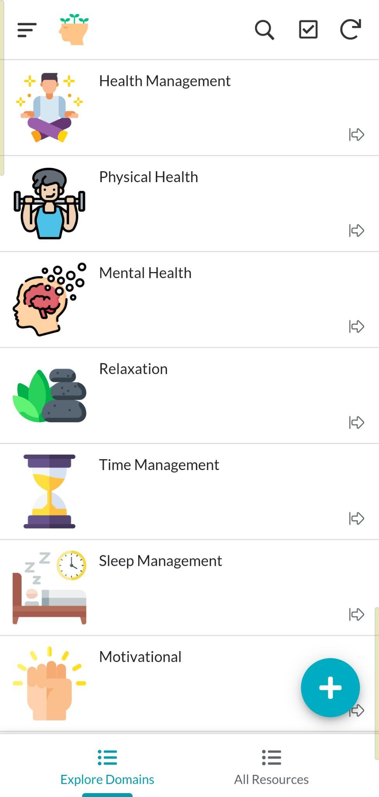
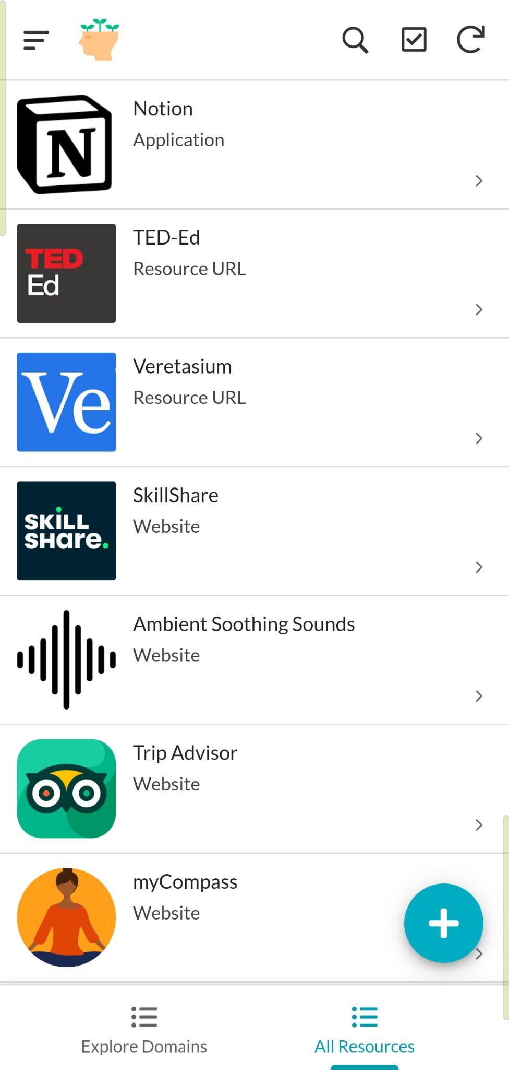
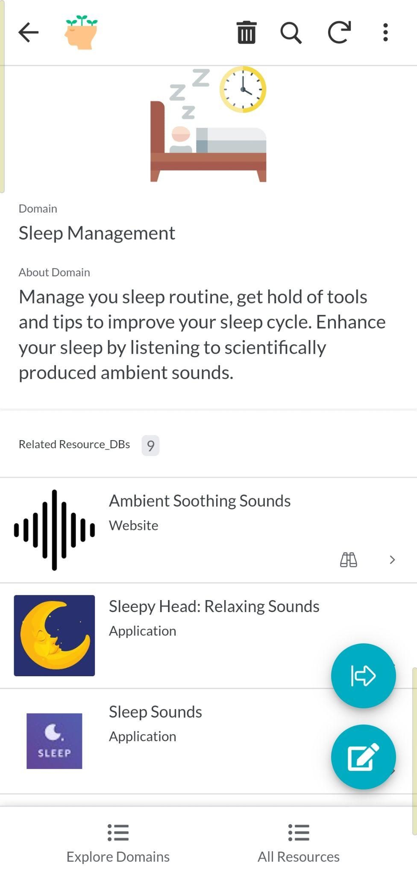
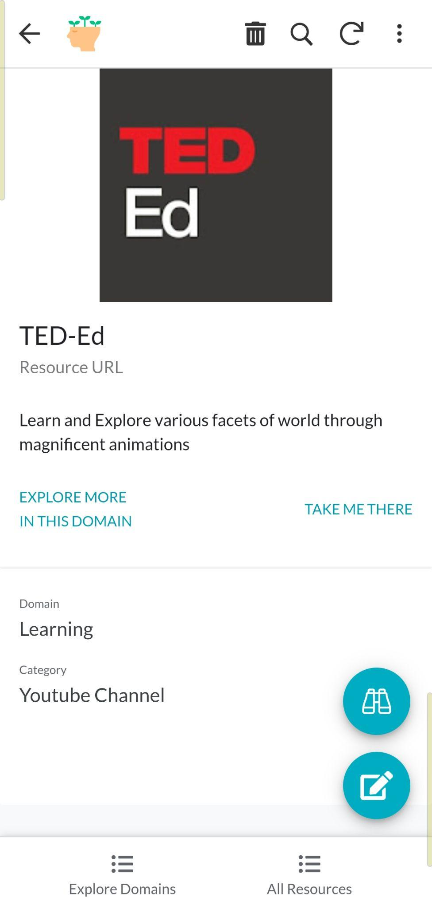
Current Status (contd.)
Application view on Mobile Device

Slide 11
Timeline
Project modules to be completed in VII Sem -
Designing the Database (1 wk)
Refining deliverables (- wk)
Updating the Database with records (- wk)
Development of application (9 wk)
Integration and Testing (4 wk)
Deployment of application (1 wk)

Slide 12
References
Paper Reference
Rizvi, Yasmeen & Ilyaz, Aleena. (2022). Mental Health among Millennials and Post-Millennials: The Role of Loneliness and Multi-Dimensional Perfectionism. Volume 14. 387.
Site References
https://www.sih.gov.in/sih2022PS
https://support.google.com/appsheet/topic/11828091?hl=en&ref_topic=10099895
https://psychcentral.com/blog/what-self-care-is-and-what-it-isnt
https://support.google.com/docs/table/25273?hl=en

Slide 13
Thank You!

